Slide 1
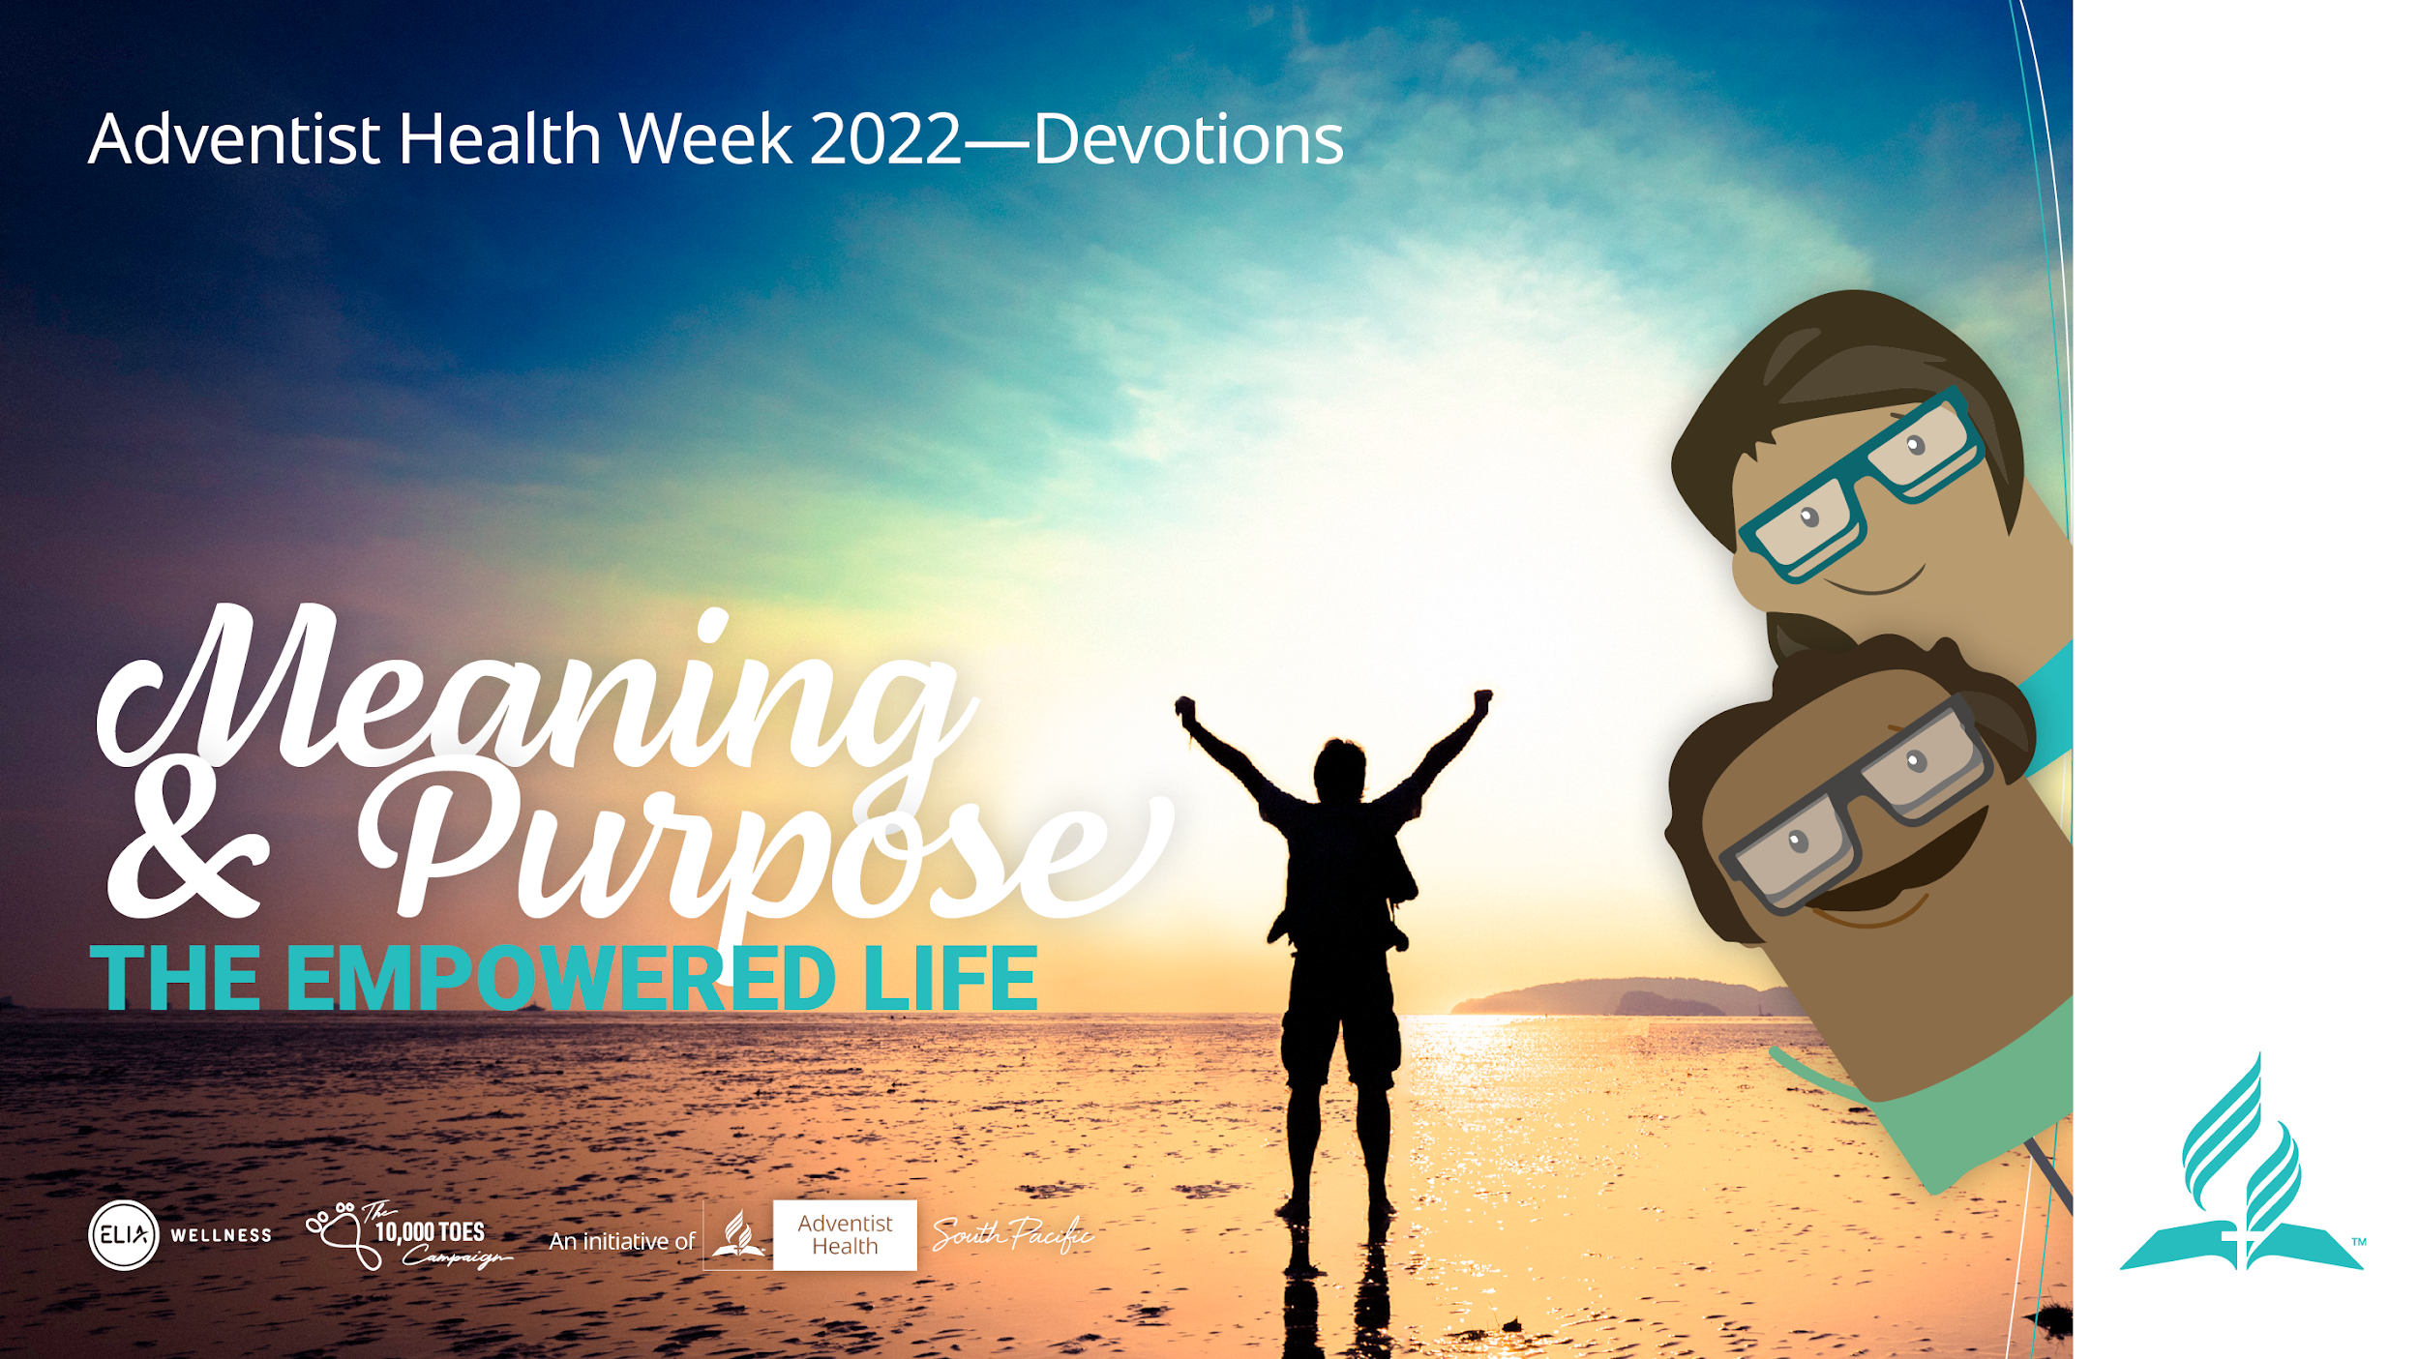
Notes:
Introduction of the Topic:
Presenter:
Welcome to the Empowered Life series devotional. Today we will be discussing meaning and purpose

Slide 2
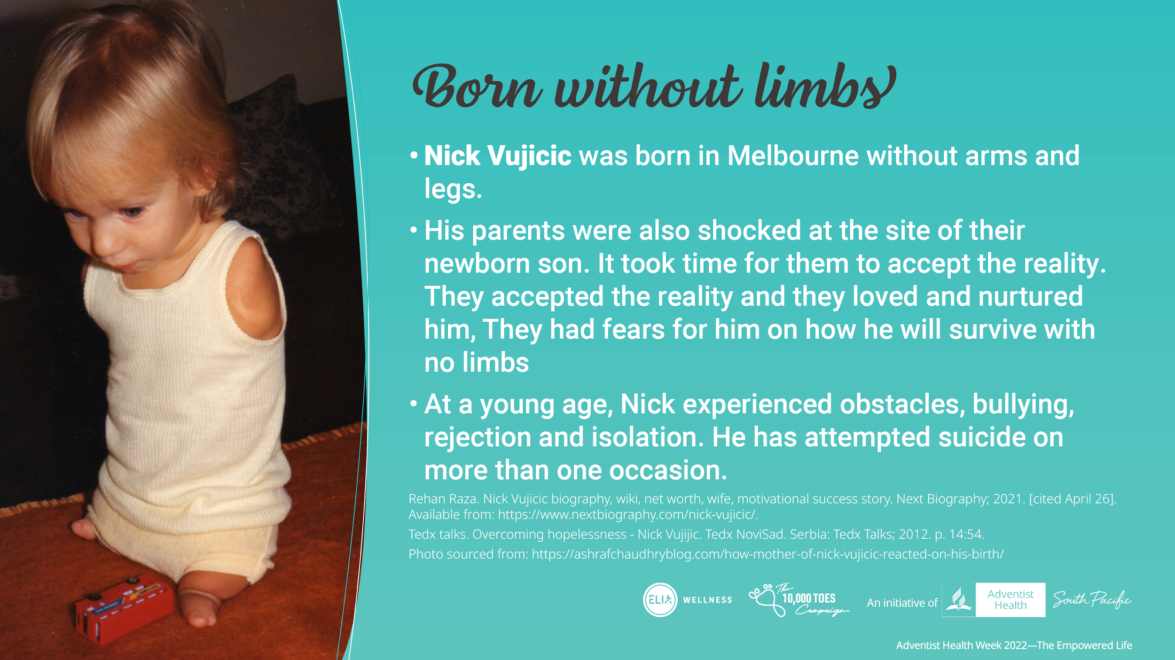
Notes:
Nick Vujicic is an Australian-American born without arms and legs. His parents were also shocked at the site of their newborn son and it took time for them to accept that this was their son. They accepted the reality and they loved and nurtured him. They had fears for him on how he will survive with no limbs.
He became depressed at a young age when he lost his sense of meaning and purpose in life after experiencing obstacles, facing bullying, rejection and isolation. He attempted suicide but the images of his parents and brother in his mind prevented him from being able to proceed the suicide.

Slide 3
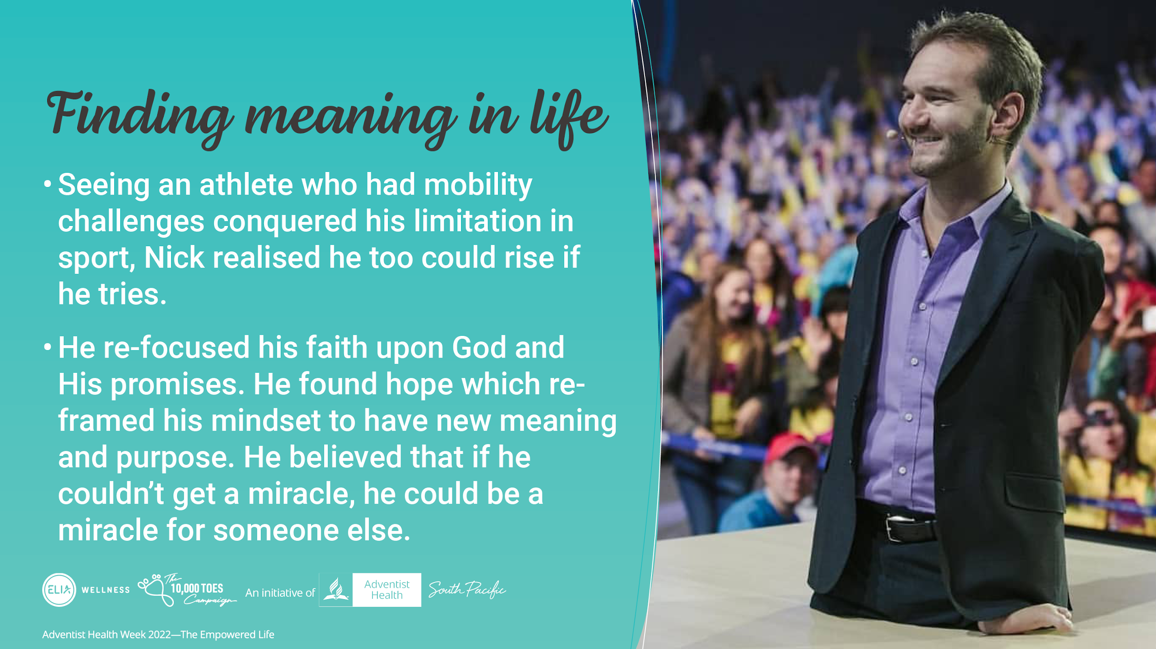
Notes:
Nick saw someone who was disabled, who conquered his limitation in sport and realised he doesn't have to remain “unable”.
When he re-shifted his focus upon God and His promises, he found hope which reframed his mindset of his meaning and purpose in life. He realised if he can’t get a miracle, he realised he could be a miracle for someone else.
NIck then ventured to do many adventurous things, played sports and he met a beautiful bride and today has 4 children.
Today he is a renowned world speaker, Christian evangelist, author, coach, entrepreneur because he found meaning and purpose, and lives it.

Slide 4
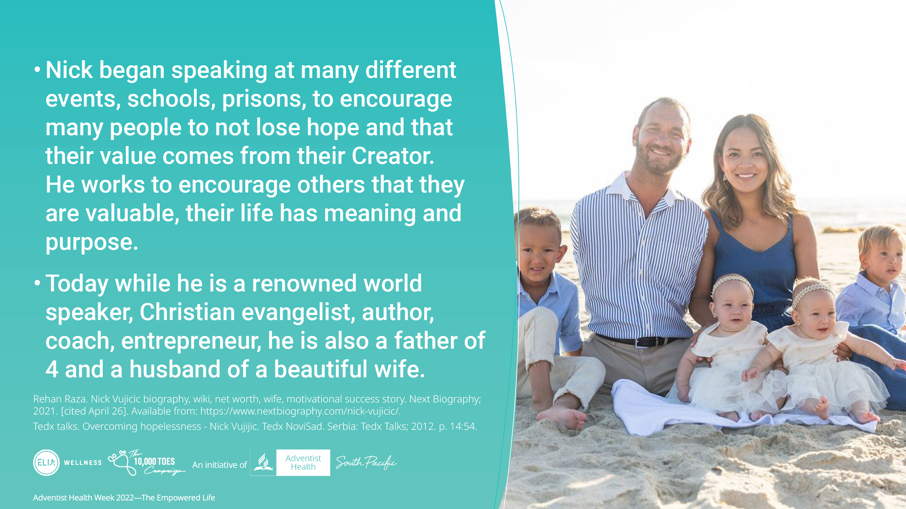
Notes:
Nick then ventured to do many adventurous things, played sports and spoke at many different events to give people a renewed sense of hope and meaning in their lives. While engaged in the various talks, he met a beautiful bride and today has 4 children.
Today he is a renowned world speaker, Christian evangelist, author, coach, entrepreneur because he found meaning and purpose, and lives it.

Slide 5
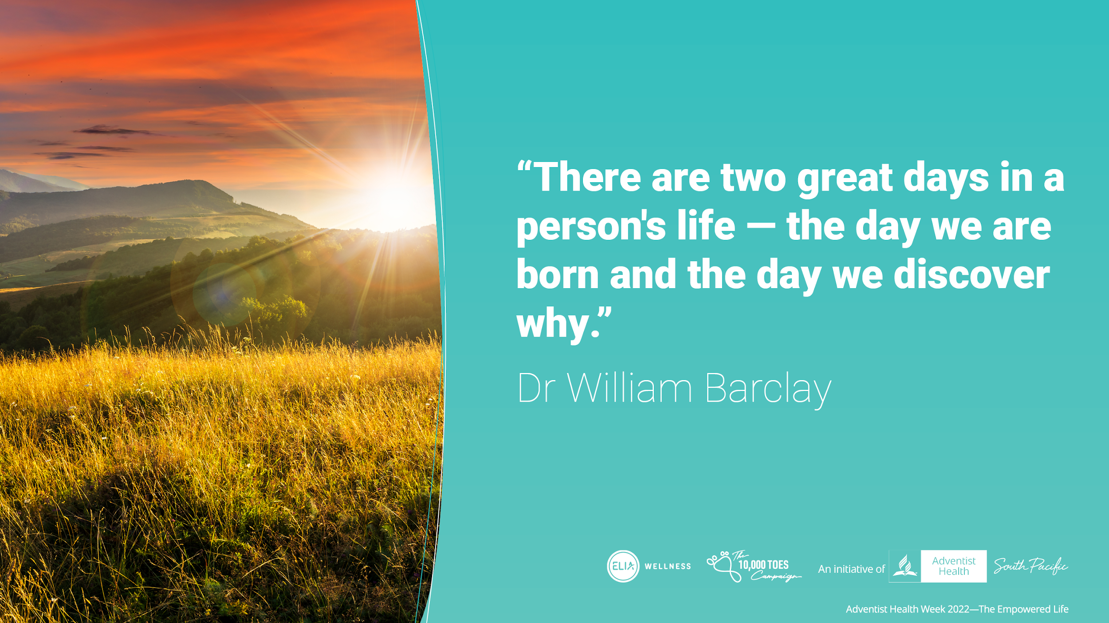
Notes:
Considering Nick’s life, one can stay in the same rut of hopelessness and not search for meaning in their lives or they can choose to live their future with a different lens.
Read quote.
The day we discover our purpose and why we exist, will be the start of our journey living a more satisfying and rich life.

Slide 6
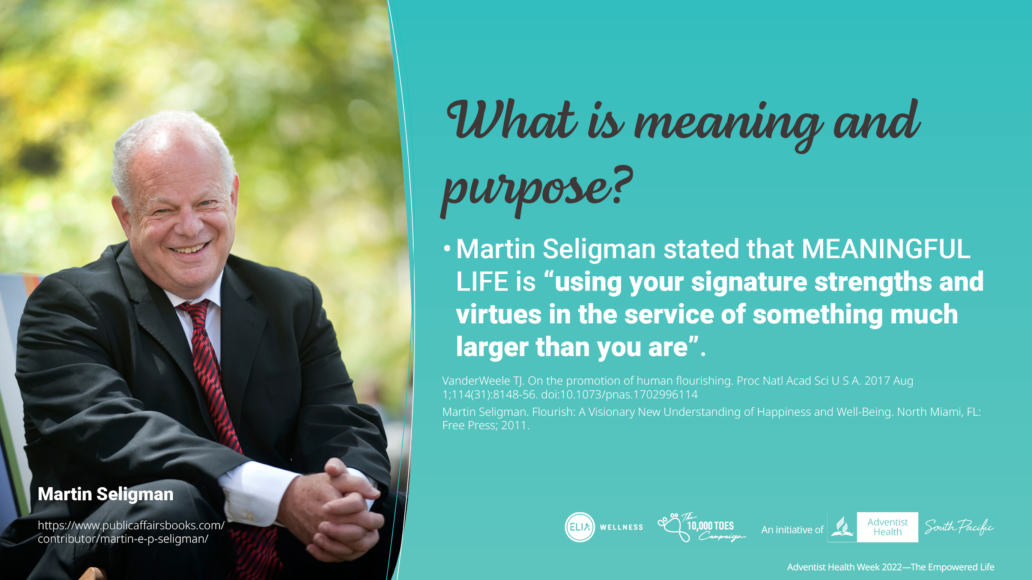
Notes:
Human beings have intrinsically searched for the meaning of life, meaning in life and finding their sense of value and purpose. Many have asked what is the meaning of life since we exist? Why do we even exist? What is our purpose here?
Finding the answers to the meaning and purpose of life contributes to the ability for individuals to flourish
Everyone has a unique journey and perspective on what is regarded as the discovery of the meaning and purpose of life. For some, meaning may be discovered through career, political or social cause, altruism through volunteering, extracurricular activities or religious/spiritual belief
Martin Seligman, known as the father of Positive Psychology stated that MEANINGFUL LIFE is “using your signature strengths and virtues in the service of something much larger than you are”

Slide 7
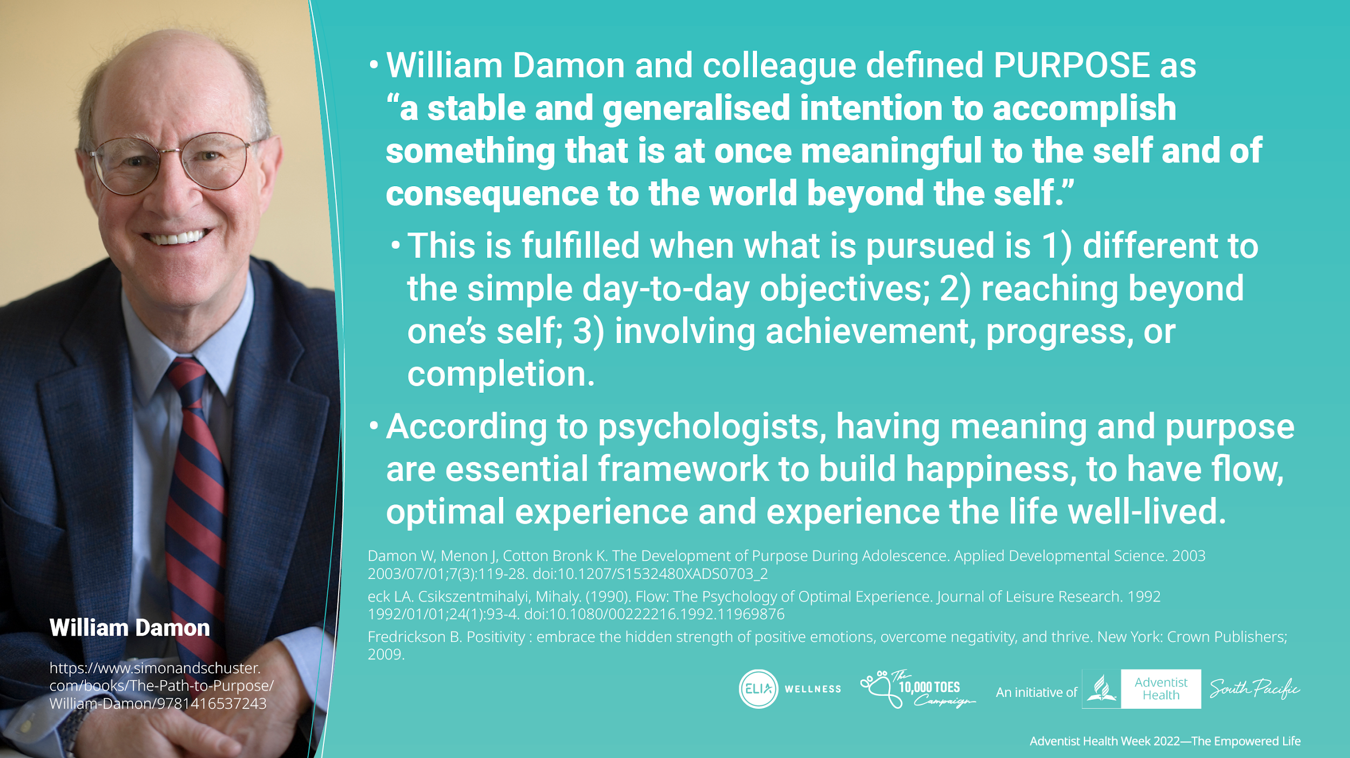
Notes:
William Damon and colleague, who is a Professor of Education in Standford University defined PURPOSE as “a stable and generalised intention to accomplish something that is at once meaningful to the self and of consequence to the world beyond the self.”
This is fulfilled when what is pursued is 1) different to the simple day-to-day objectives; 2) reaching beyond one’s self; 3) involving achievement, progress, or completion.
According to psychologists, having meaning and purpose are essential framework to build happiness, to have flow, optimal experience and experience the life well-lived.

Slide 8
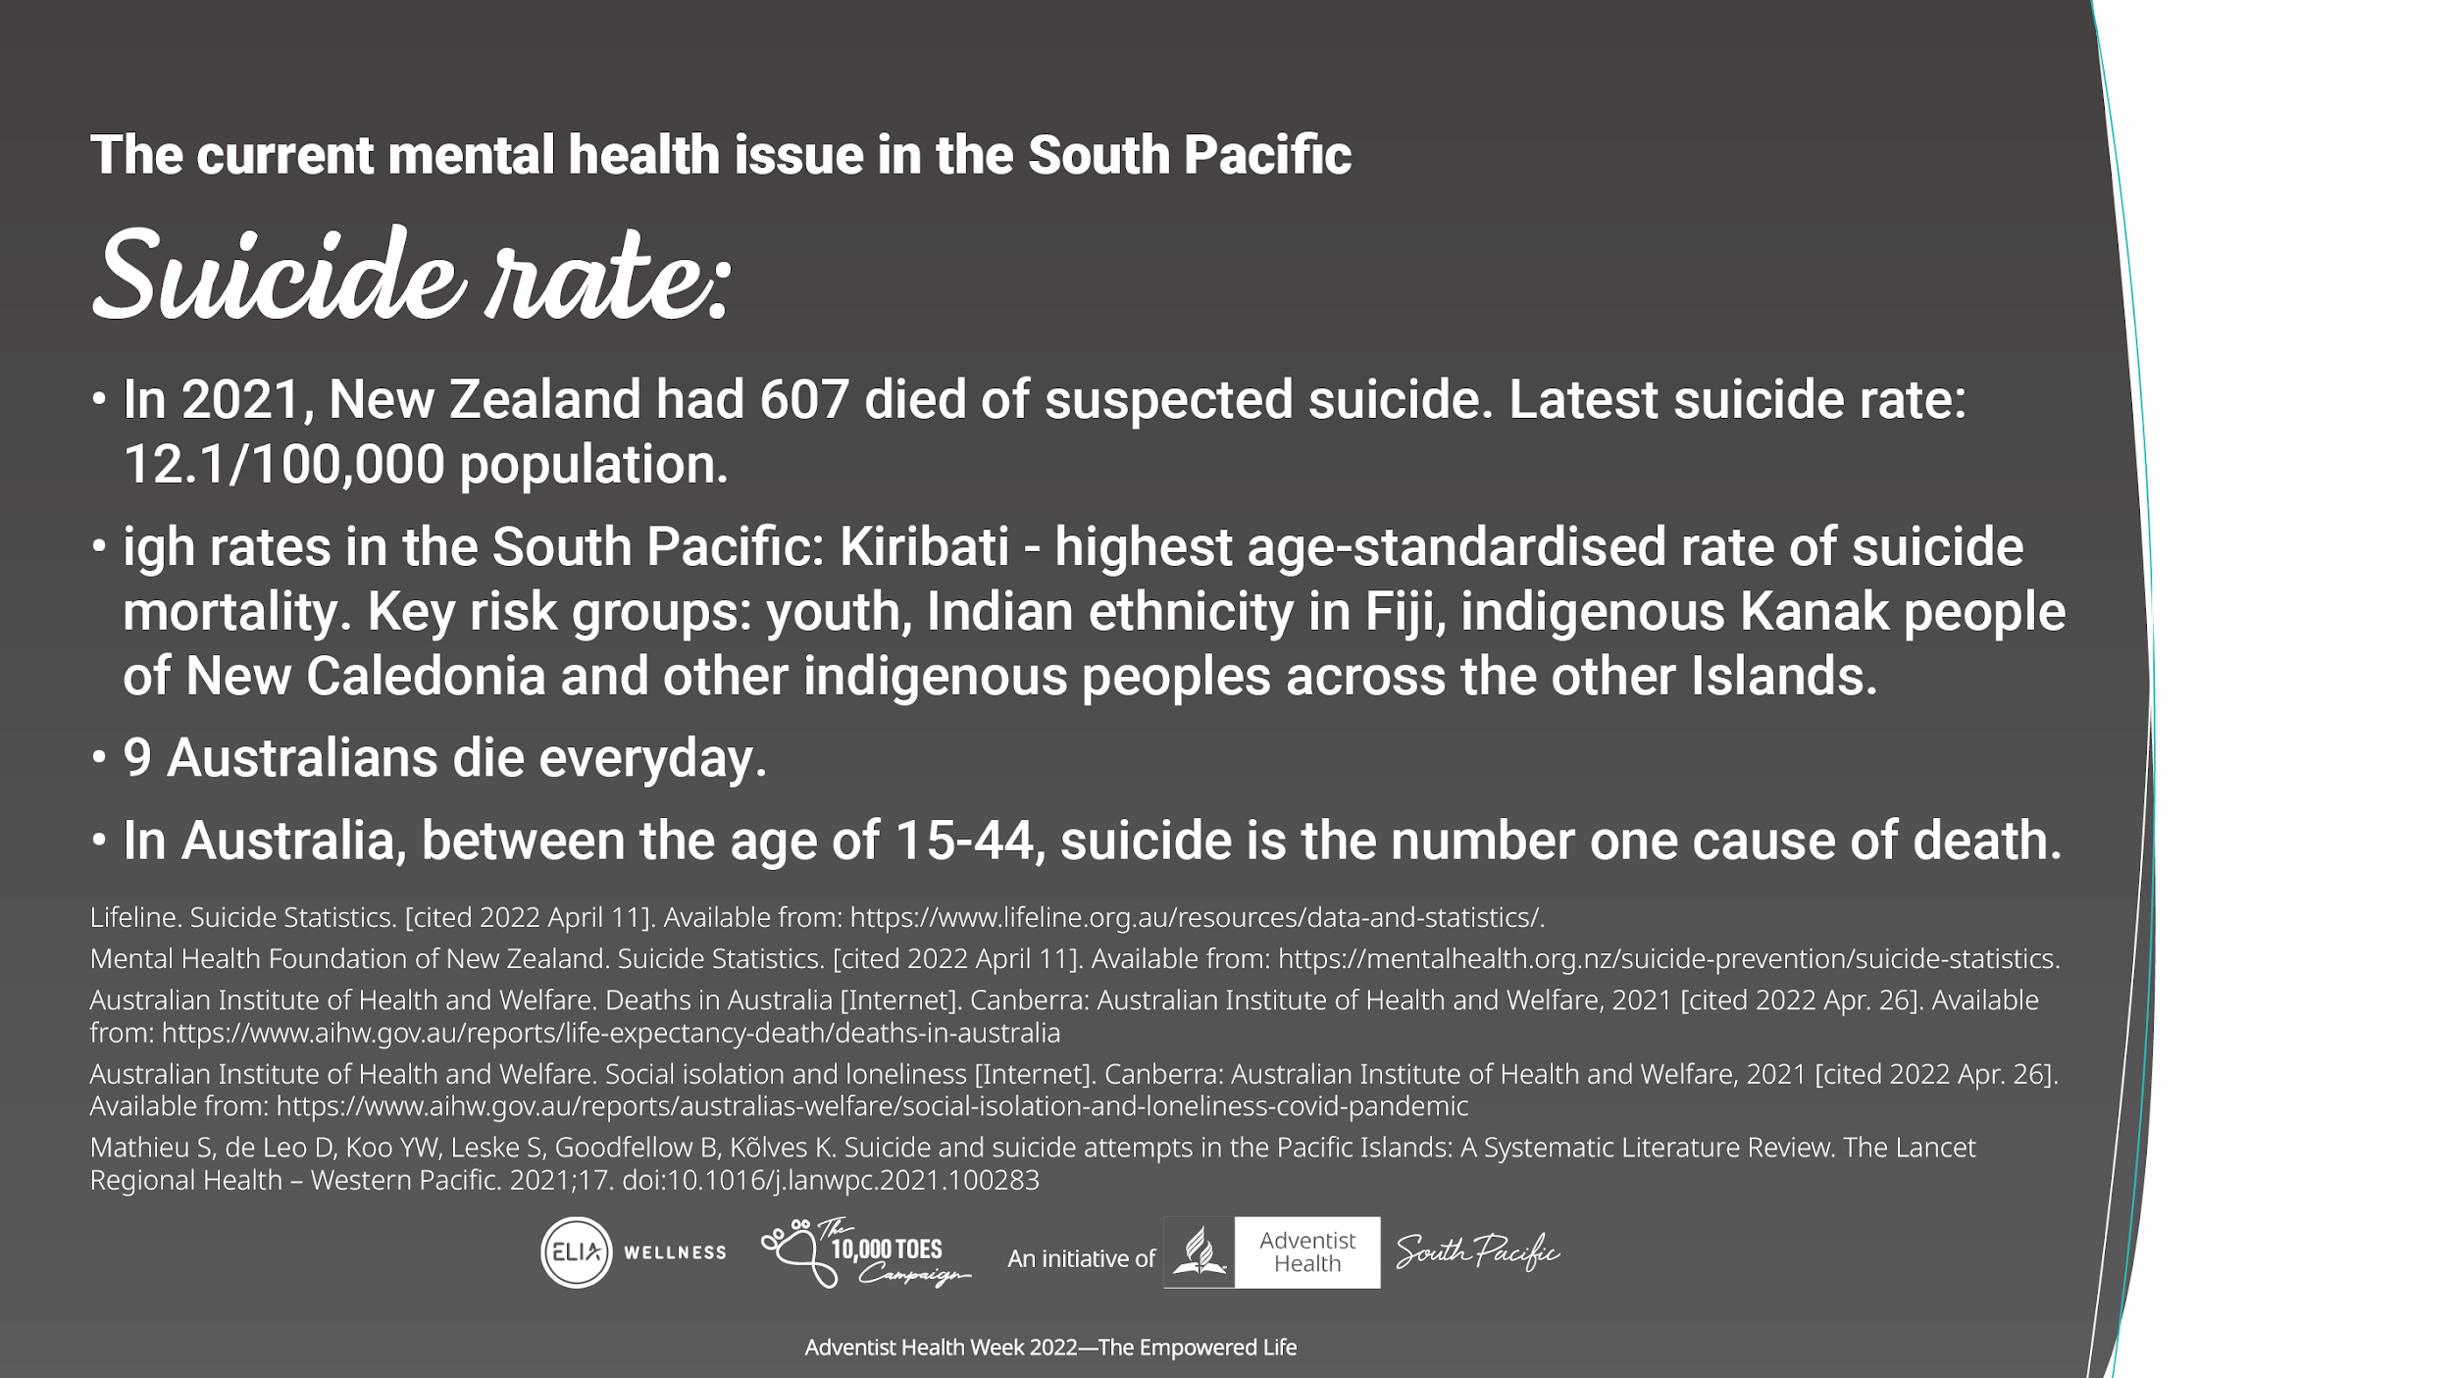
Notes:
The South Pacific are made up of beautiful countries with what some would call as paradise. But even in the midst of beautiful places, we live in a broken world filled with many challenges because there is no sense of hope, direction and meaning to one’s life. Suicide has become the next answer to silence the torture and emptiness that surround them. The rate of suicide across the South Pacific:
In 2021, New Zealand had 607 died of suspected suicide
We also have high suicide rates in the South Pacific: Kiribati - highest age-standardised rate of suicide mortality. Key risk groups: youth, Indian ethnicity in Fiji and Indigenous peoples across other Islands
Nine Australians die everyday.
Between the age of 15-44, suicide is the number one cause of death in Australia
Many people, unfortunately lack direction in life and when hardship comes around, there can be a loss of value of their own lives, loss of hope, which may lead to suicide, or harming one self through different means. But when there is an experience with significance beyond the trivial mundane things, and beyond the serving of one self, new meaning and purpose can emerge.

Slide 9

Notes:
Let’s look at the benefits in having meaning and purpose based on what some research groups have found.

Slide 10
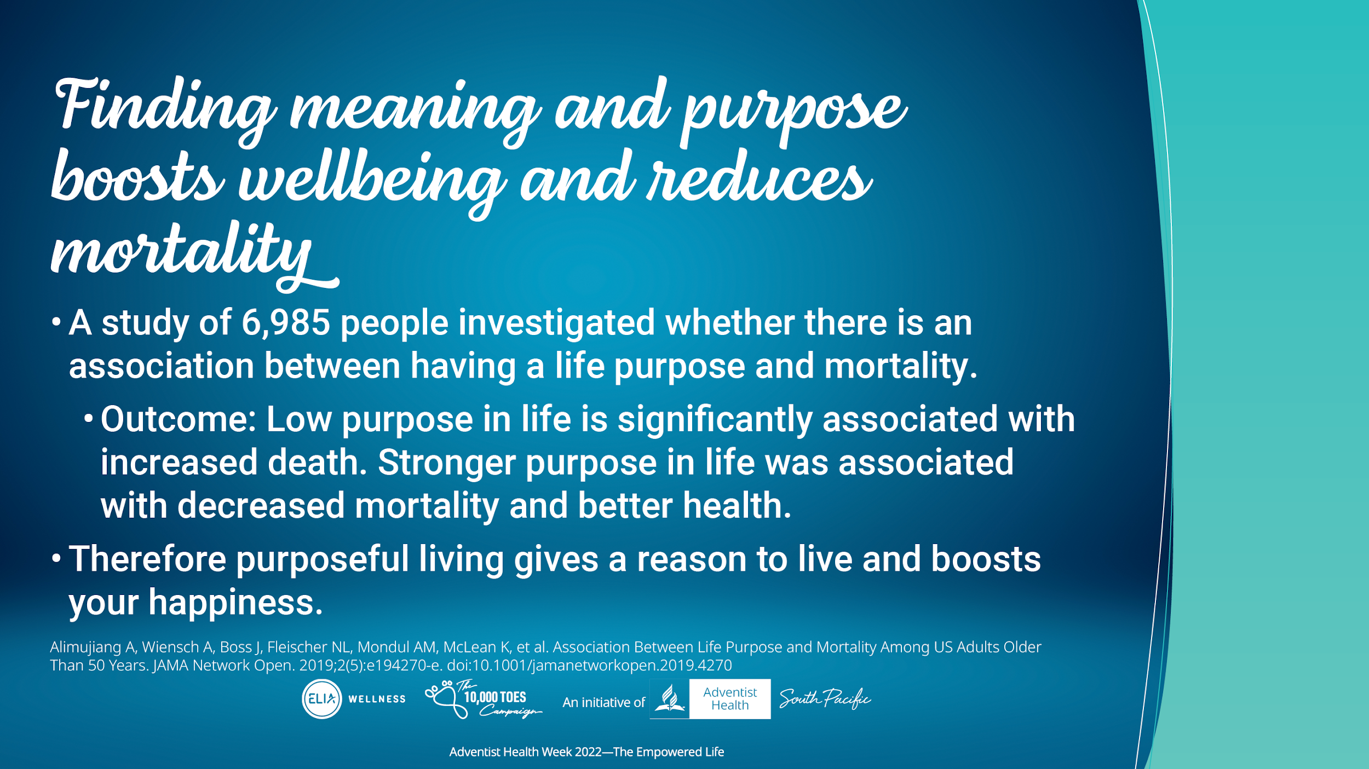
Notes:
A study of 6985 people investigated whether there is an association between having a life purpose and mortality.
The participants filled in a purpose in life assessment (Alimujiang, et al, 2019).
The outcome of the study showed that stronger purpose in life was associated with decreased mortality and better health
Therefore purposeful living gives a reason to live and boost your happiness

Slide 11
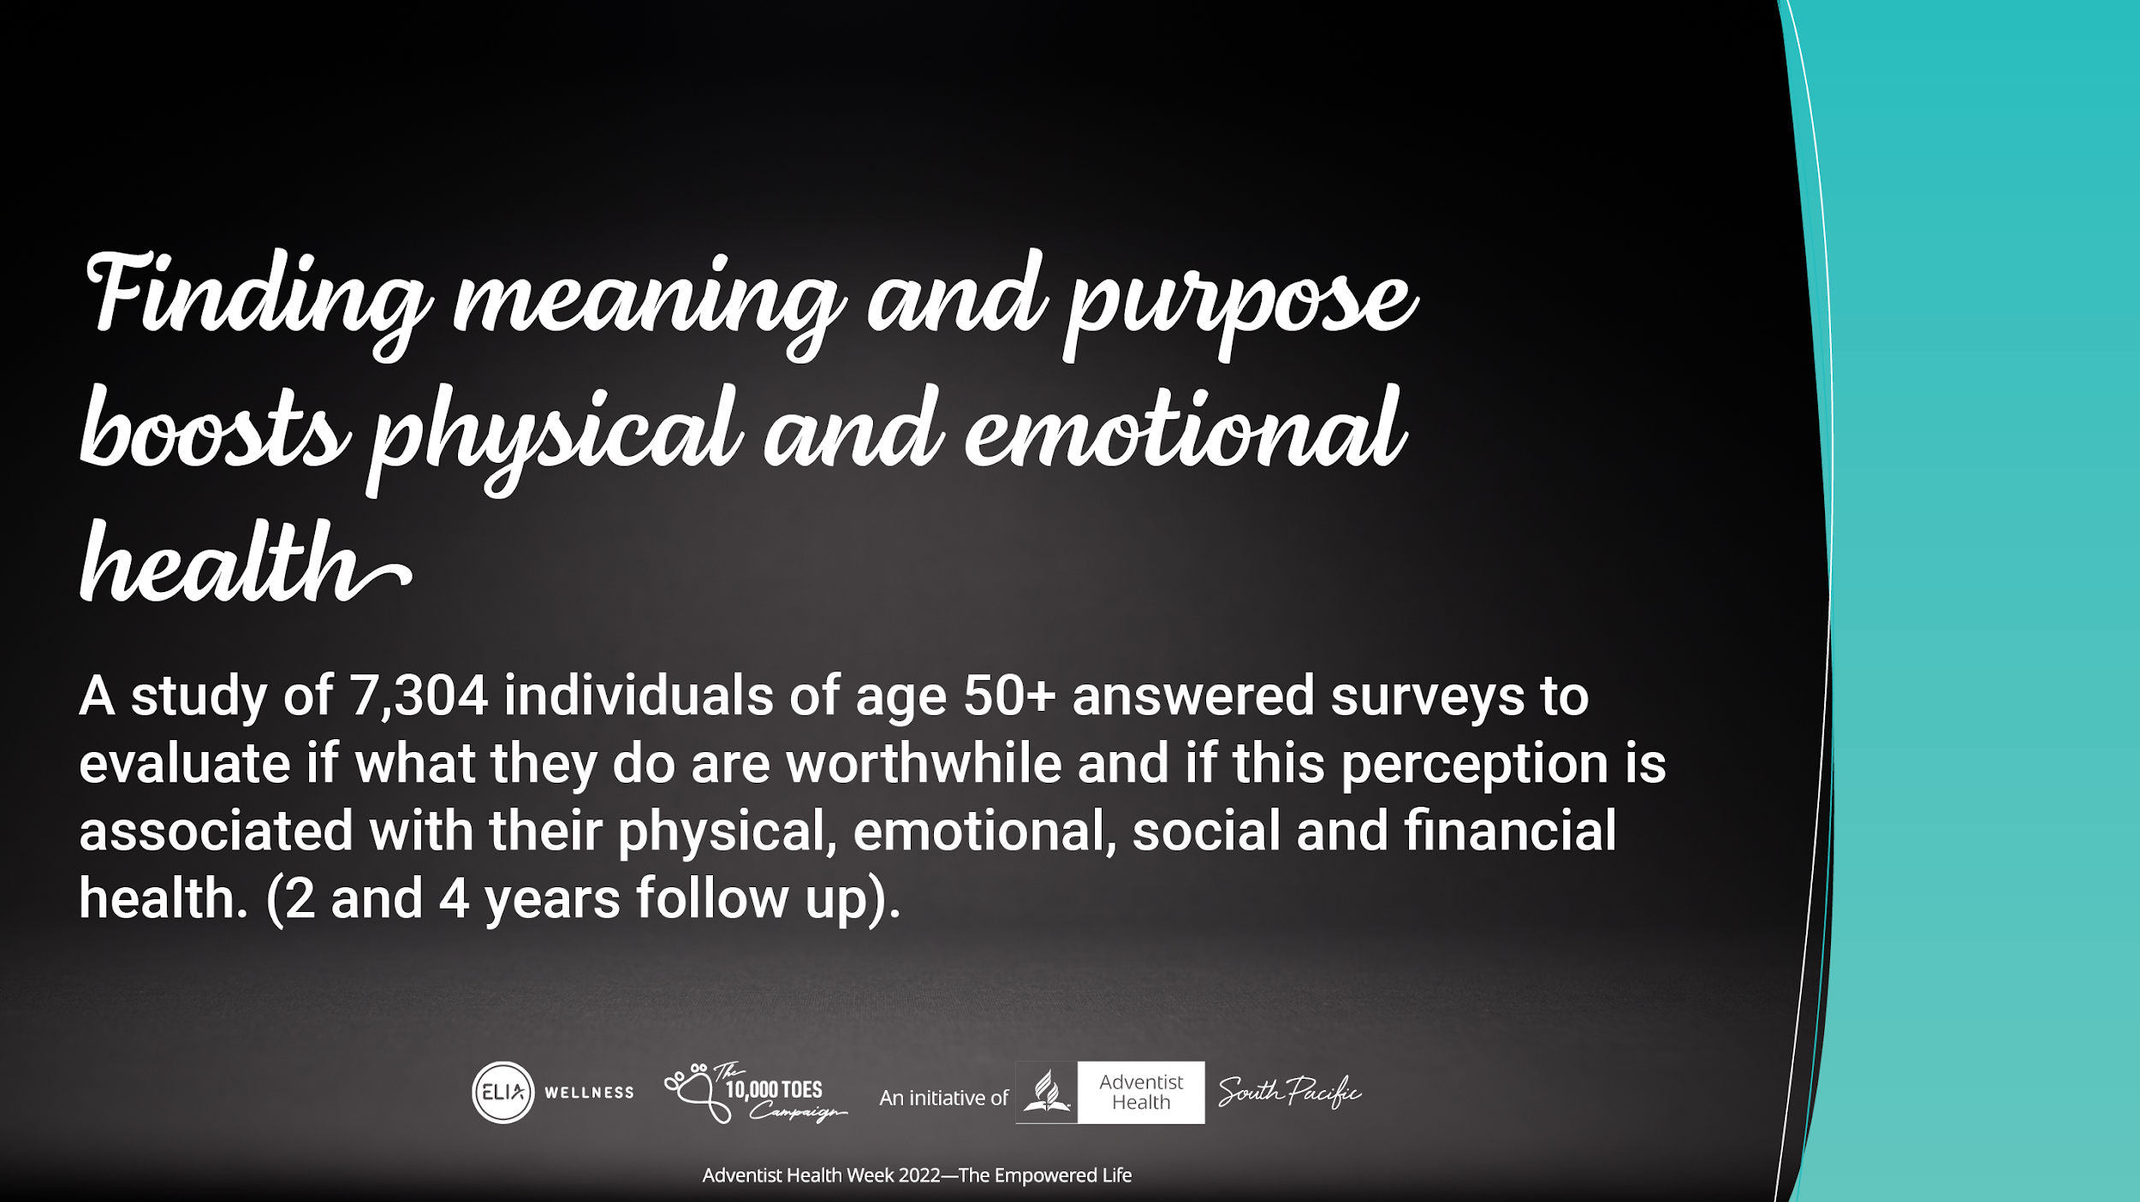
Notes:
A study looked at 7304 individuals at age of 50+ (median age was 67.2 years) answered surveys to evaluate if what they do in life are worthwhile and if this perception is associated with their physical, emotional, social and financial health. Follow up was done at 2 and 4 years later.

Slide 12
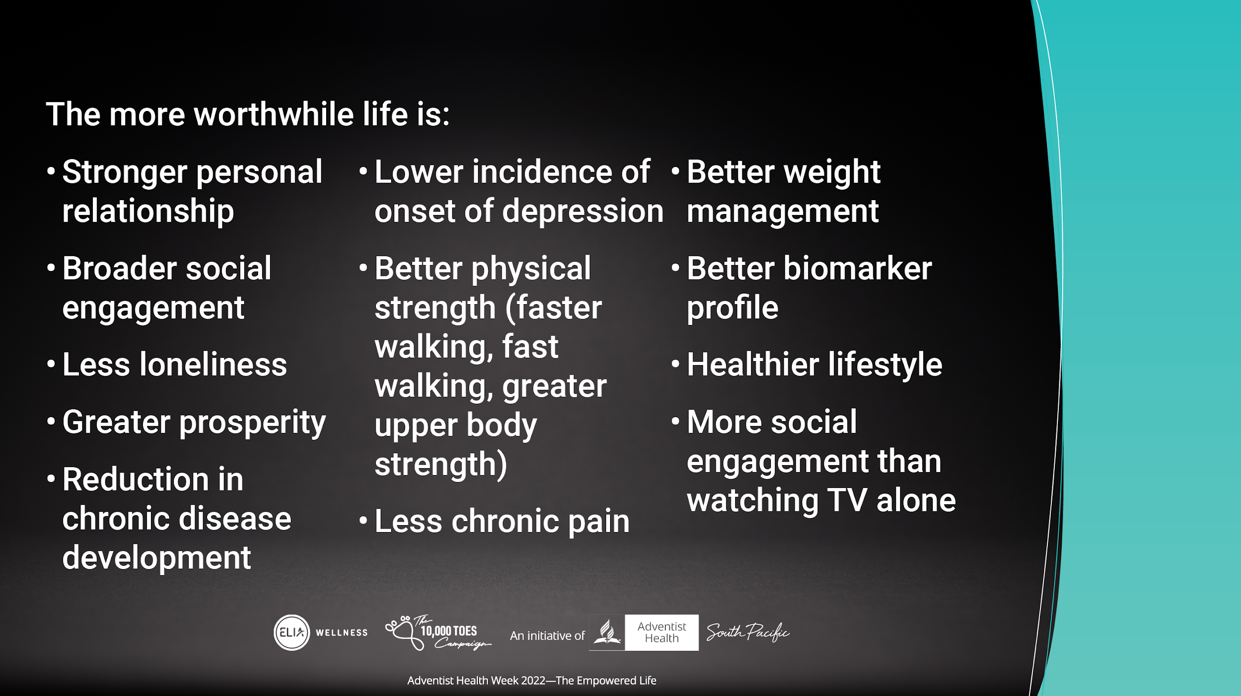
Notes:
The more the participants saw how worthwhile life is, or how meaningful life is, the:
Stronger their personal relationships, the broader social engagement, etc (go through the list briefly)

Slide 13
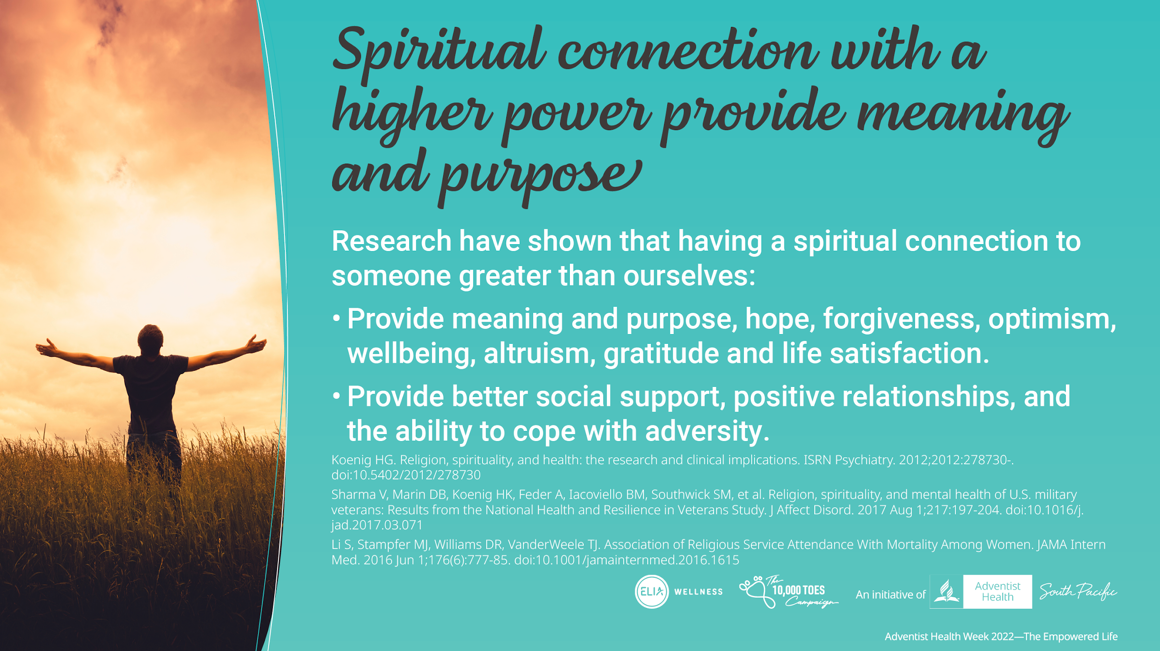
Notes:
Furthermore, research has shown that those who have spiritual connection with a higher power gain meaning and purpose, and a whole lot more with hope, forgiveness, optimism, wellbeing, altruism, gratitude, life satisfaction, social support especially during the times of adversity in life.

Slide 14
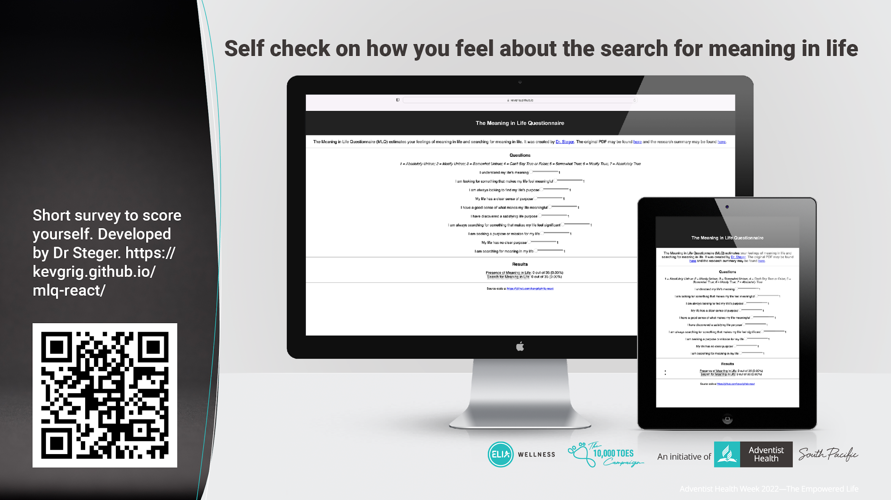
Notes:
Here’s a fun thing you can do on the side to self check on how you feel about your search for meaning of life.

Slide 15
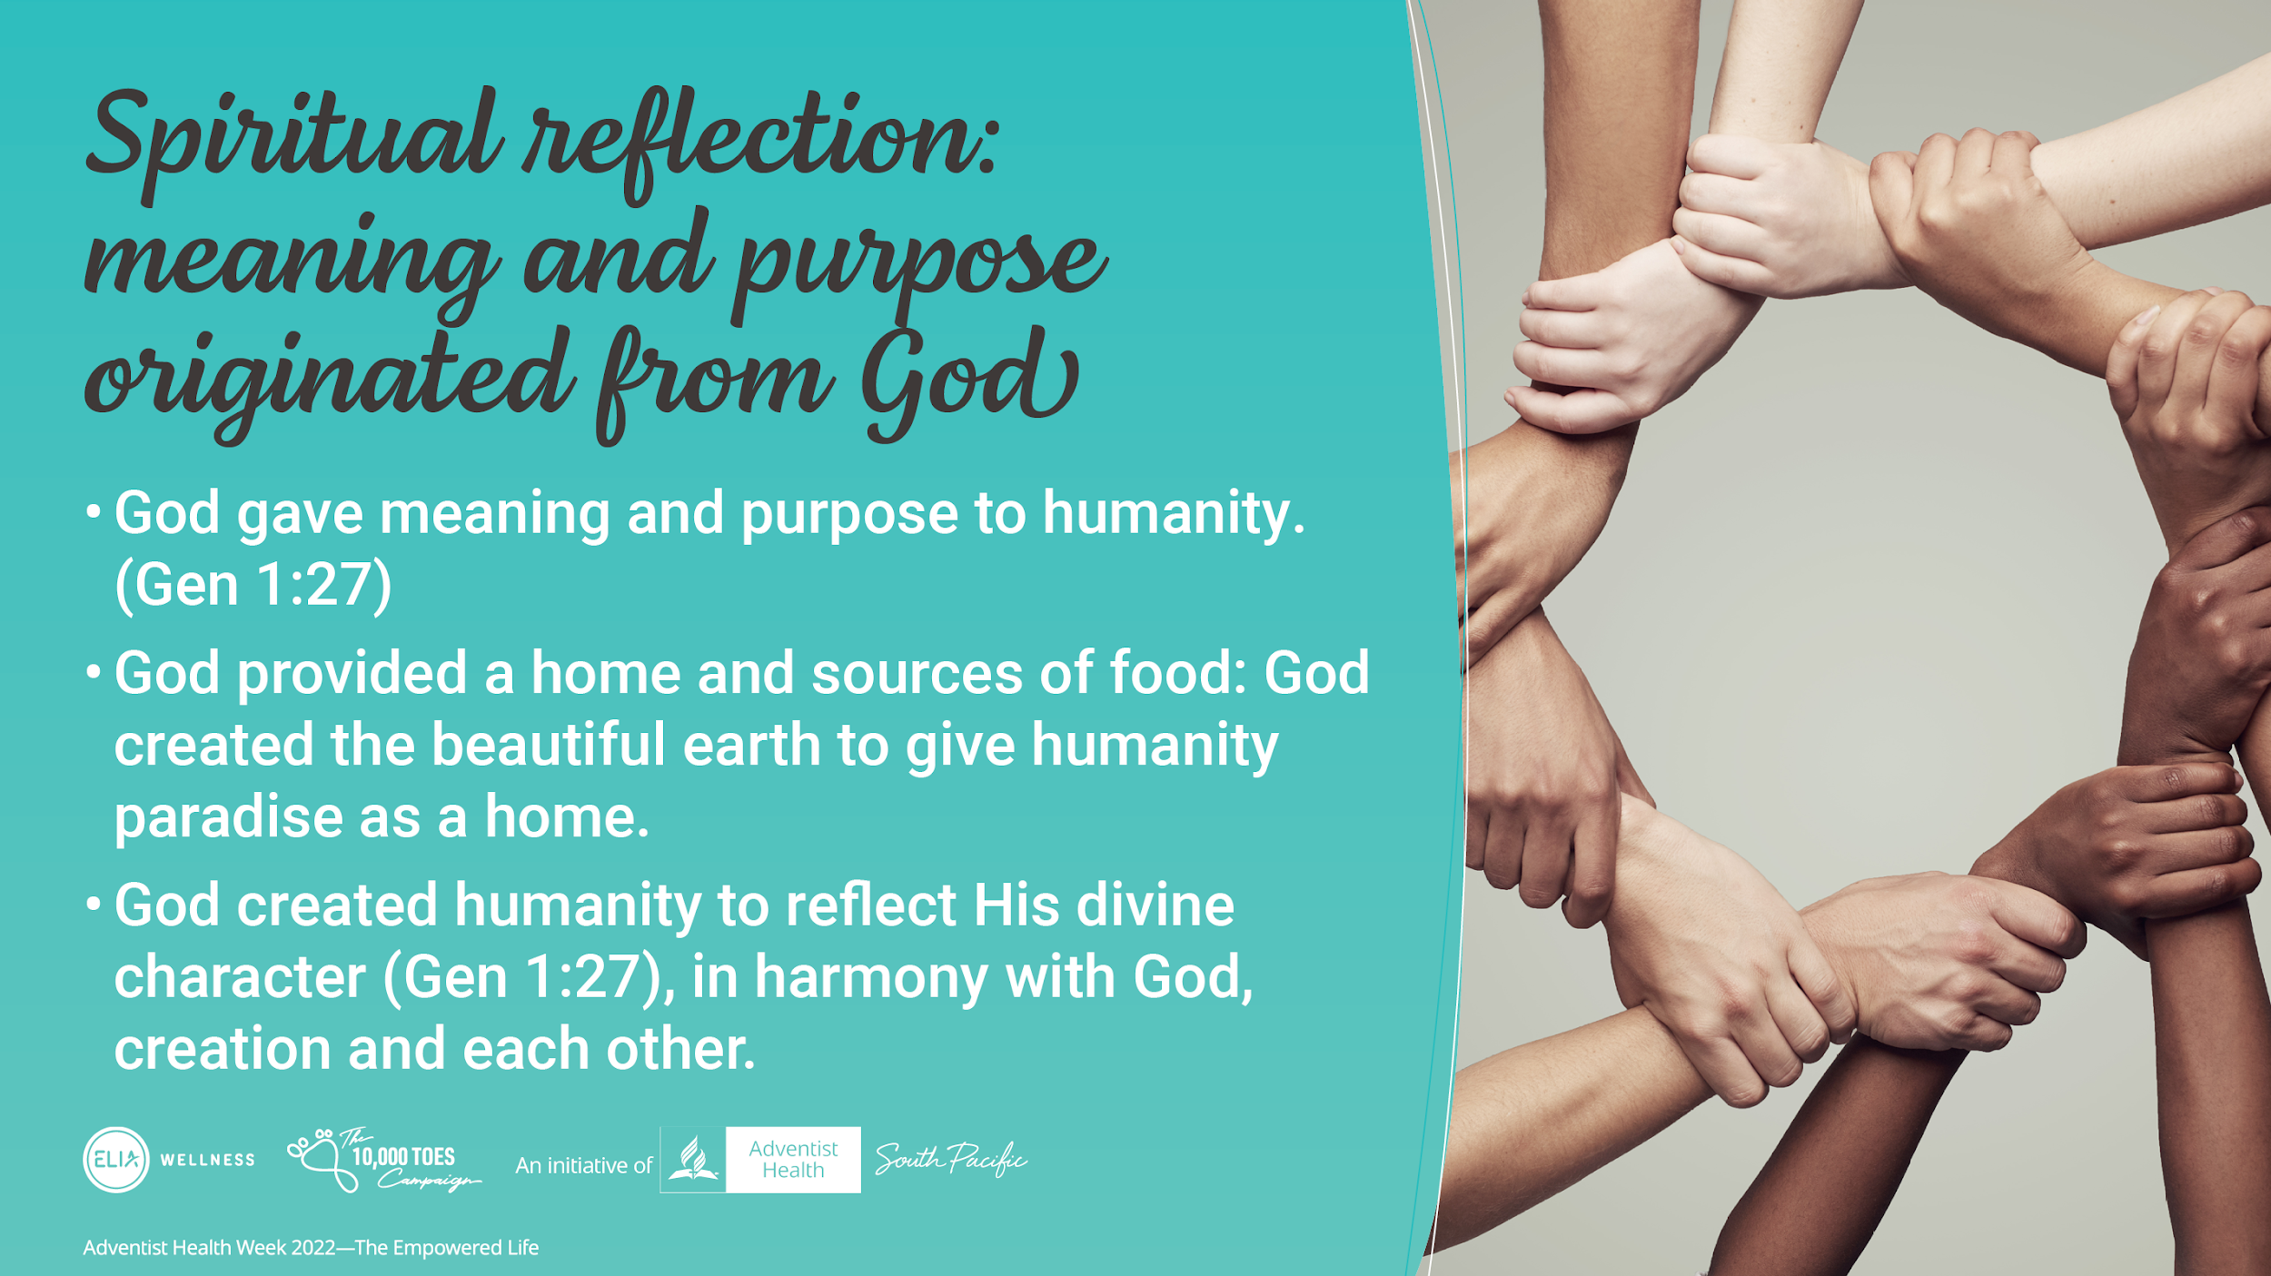
Notes:
So where does this concept of the need of having meaning and purpose originate from?
It begins from the start of the existence of this world.
We are not made by accident and neither are we a product of random stochastic chemical reaction.
The Bible tells us that the God of Scripture created life with a meaning and for a purpose.
When He created the earth, He created it as a beautiful paradise home for Adam and Eve and their generations.
Then God created Adam and Eve and the next generation to reflect His divine image in harmony with Him, His creation and each other.
Gen 1:27 So God created man in His own image; in the image of God He created him; male and female He created them.

Slide 16
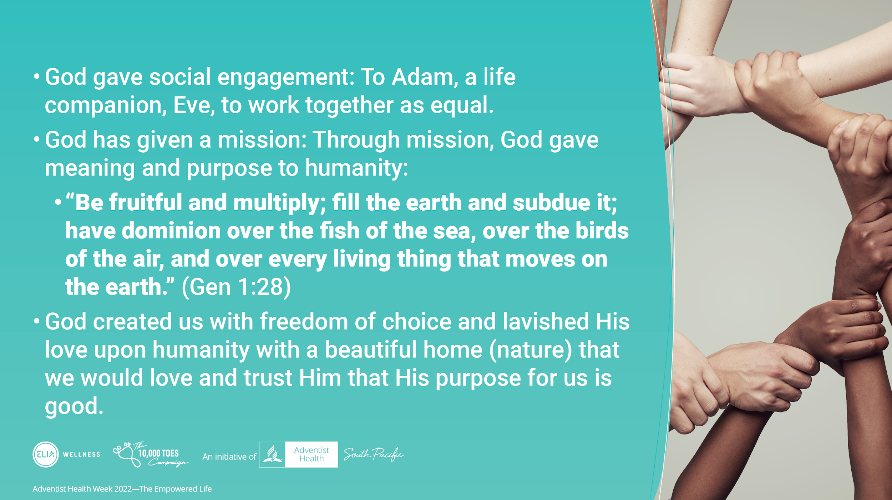
Notes:
Then God gave social engagement. He gave Adam his life companion, Eve to work together as a team.
God then gave both of them a mission. Through mission, God gave meaning and purpose to humanity.
“Be fruitful and multiply; fill the earth and subdue it; have dominion over the fish of the sea, over the birds of the air, and over every living thing that moves on the earth.” (Gen 1:28)
God created us with a freedom of choice and lavished His love upon humanity with a beautiful home (nature) that we would love and trust Him that His mission and purpose for us are good.

Slide 17
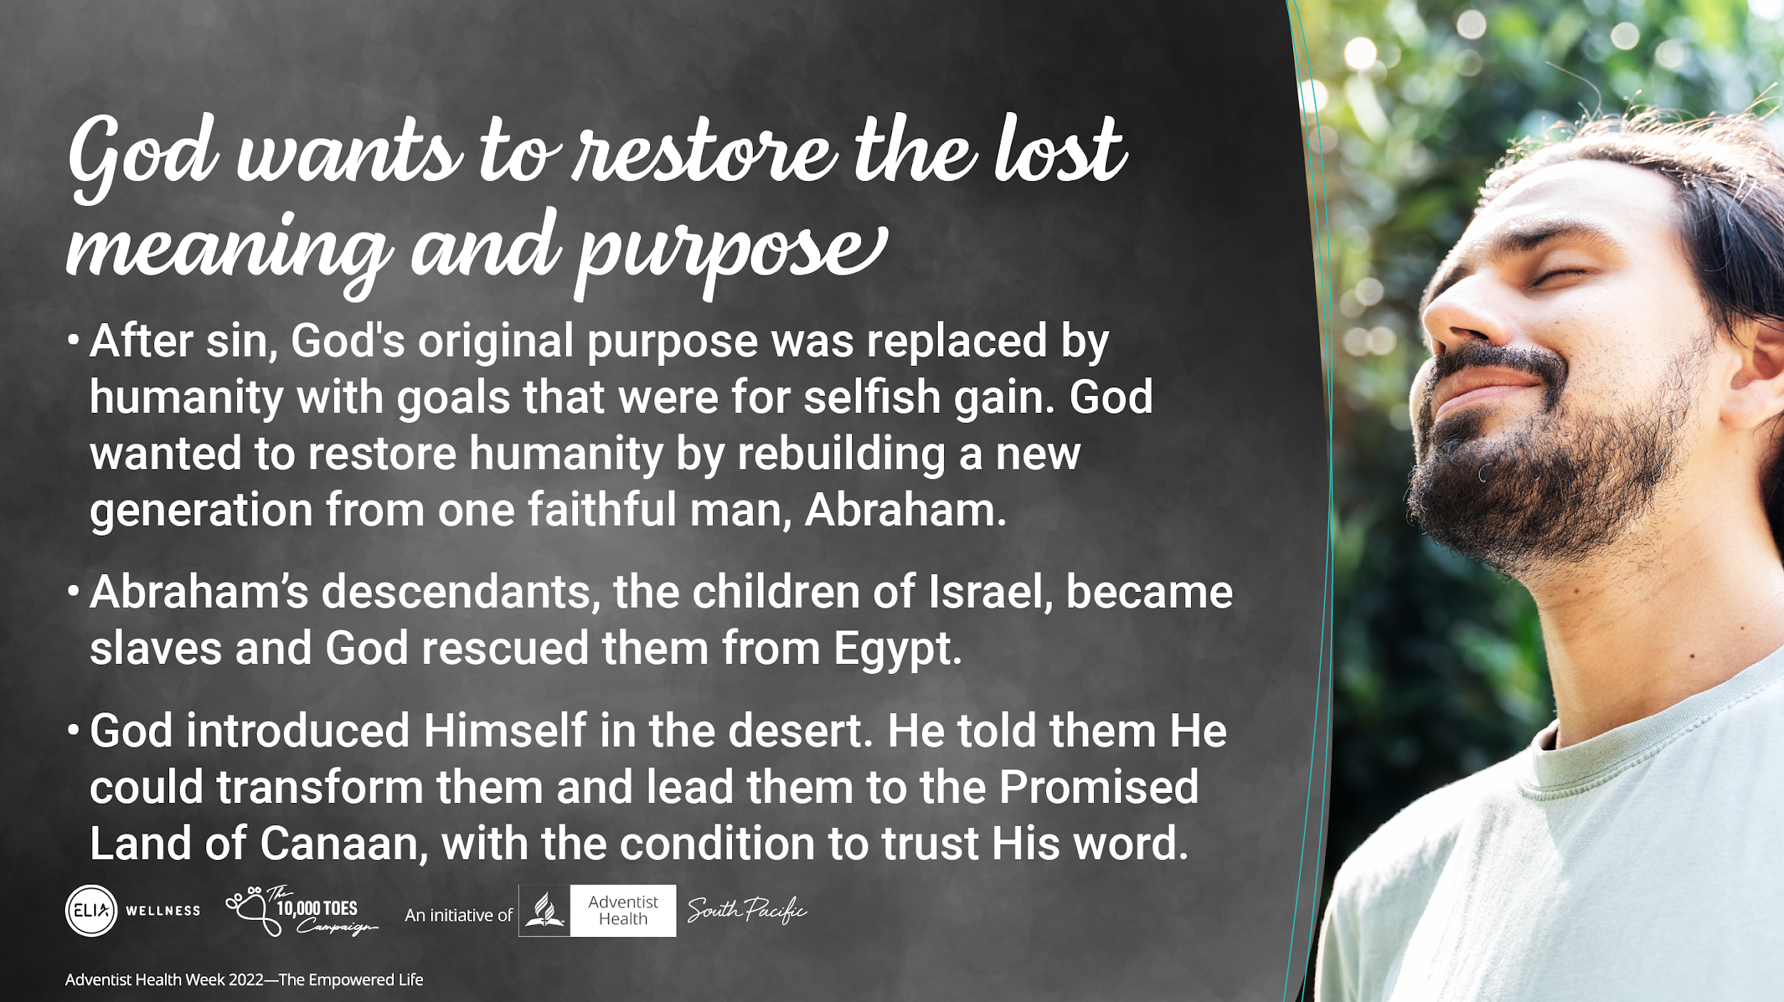
Notes:
But we know that the perfectly created world didn’t last for long in its perfection because sin came into the world and the close collaboration between mankind and God became lost and mankind wanted to do their own thing.
God’s original purpose was replaced by goals that were for selfish gain. God wanted to restore humanity.
After sin, God wanted to rebuild a new nation from one faithful man, Abraham, to show the world His love, power and goodness.
Abraham’s descendants, the children of Israel, became slaves and God rescued them from Egypt.
God introduced Himself to them in the desert. He told them He could transform them and lead them to the Promised Land of Canaan, with the condition to trust His word

Slide 18
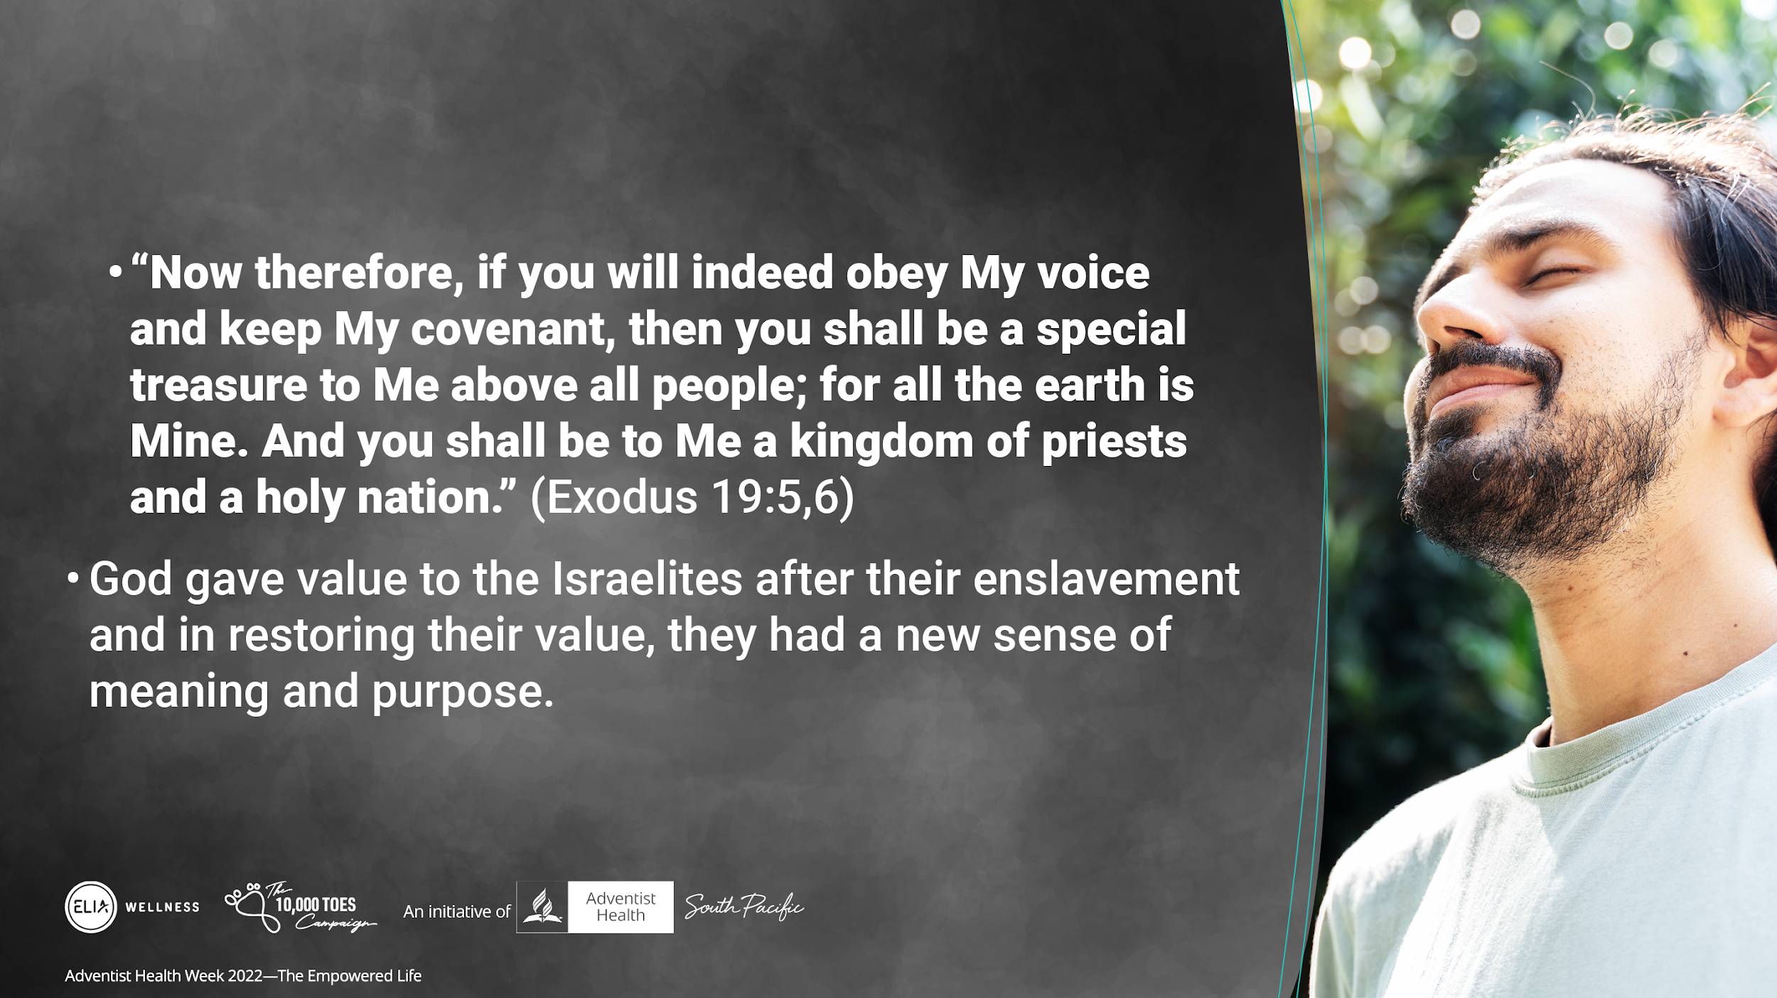
Notes:
“Now therefore, if you will indeed obey My voice and keep My covenant, then you shall be a special treasure to Me above all people; for all the earth is Mine. And you shall be to Me a kingdom of priests and a holy nation.” (Exod 19:5,6)
God gave value to the ex-slaves Israelites. But the condition was for them to trust in God’s direction and principles. in restoring their value, the Israelites had a new sense of meaning and purpose and healing in their own hearts.

Slide 19
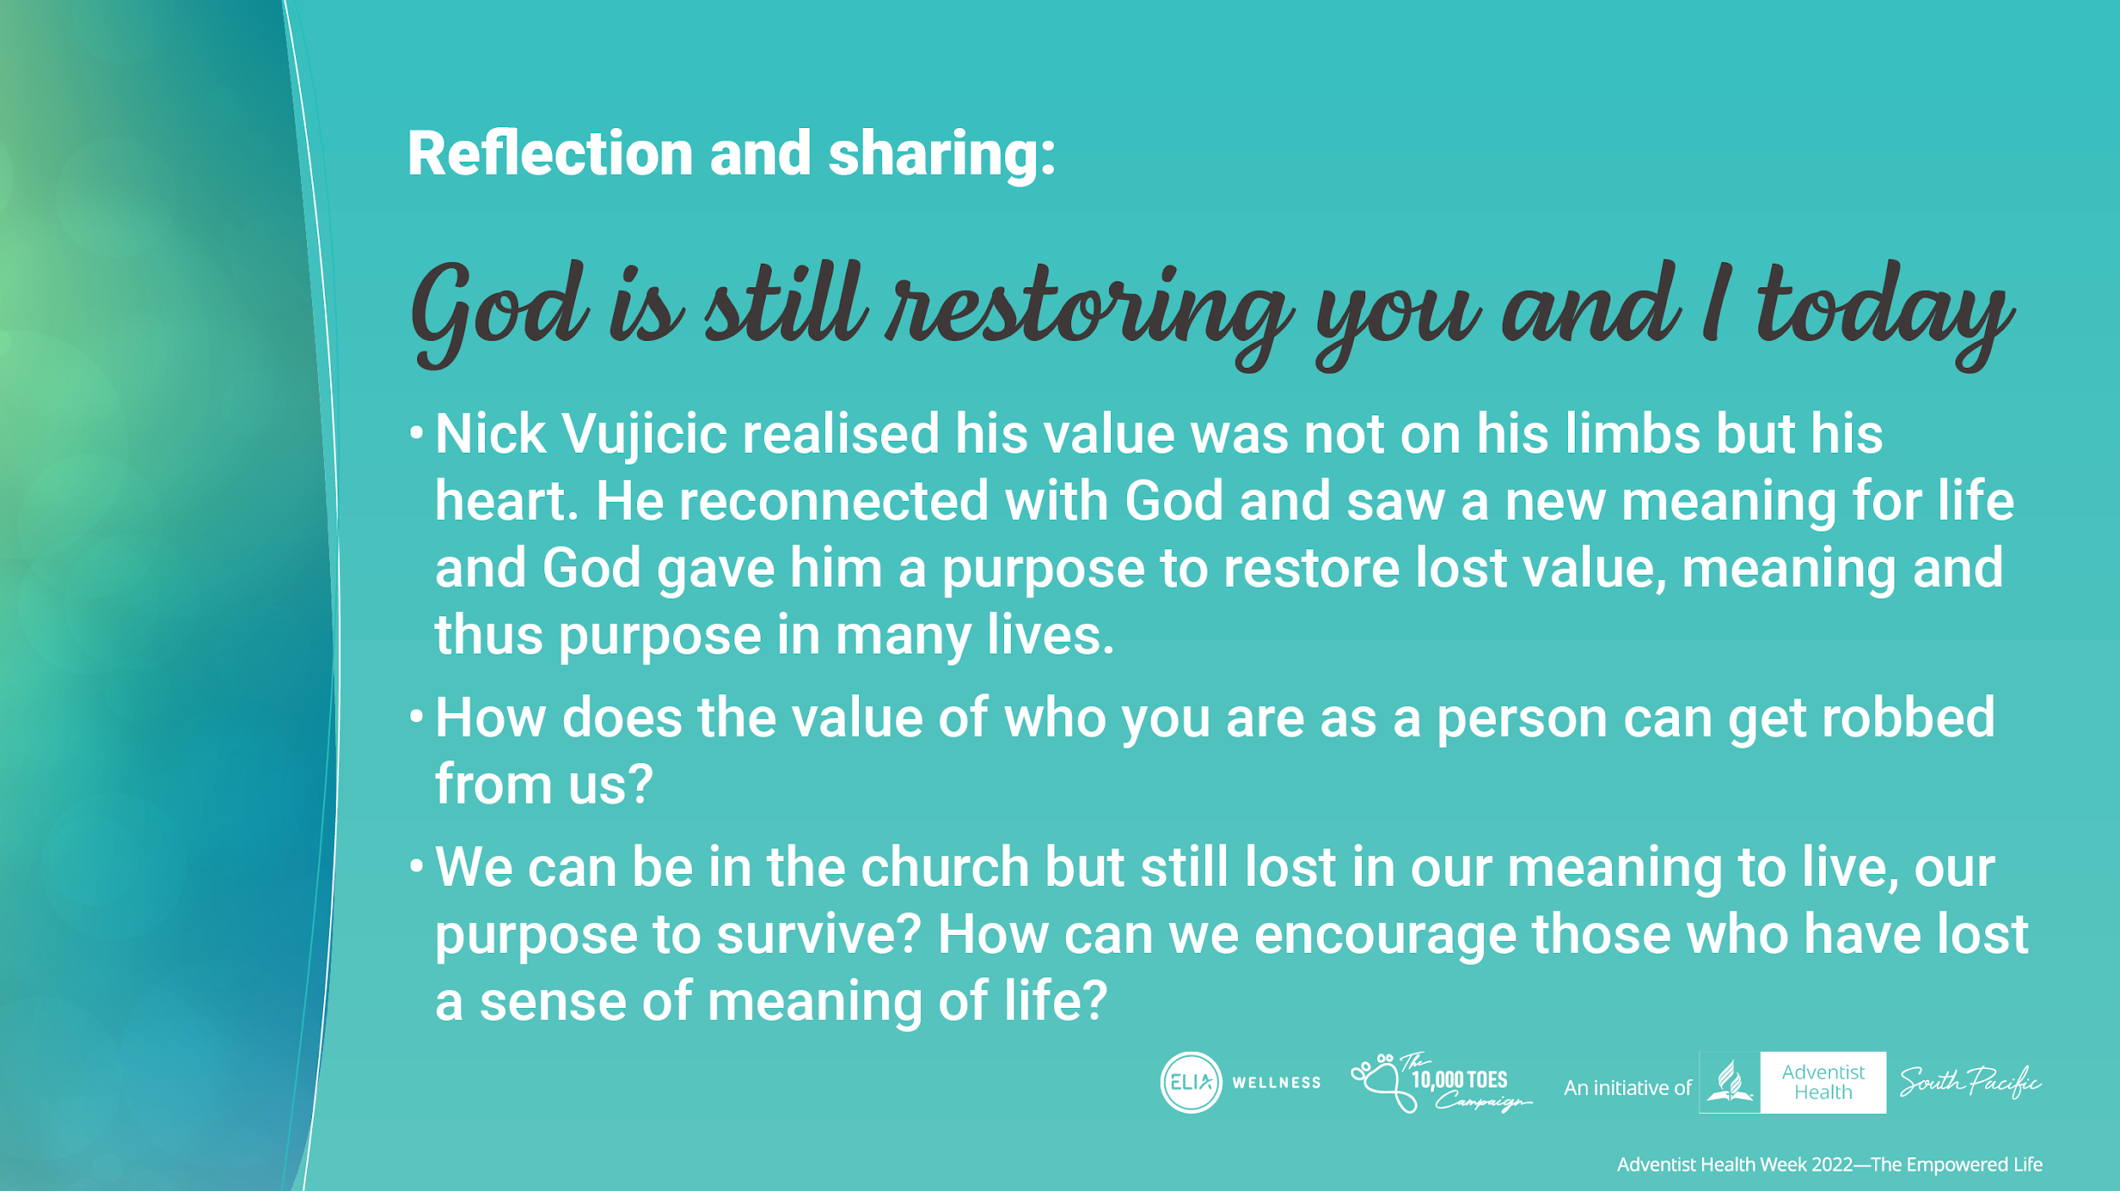
Notes:
Nick Vujicic realised his value was not on his limbs but his heart. He reconnected with God and saw a new meaning for life and God gave him a purpose to restore lost value, meaning and thus purpose in many lives.
Presenter asking the audience for discussion:
How does the value of who you are as a person can get robbed from you?
We can be in the church but still lost in our meaning to live, our purpose to survive? How can we encourage those who have lost a sense of meaning of life?

Slide 20

Notes:
Here are practical tips as Christians in the search for our purpose.
Read through the practical tips.
Daily, read Scripture and spend the time to self reflect and talk to God on the reflection.
Write down your purpose and goals. Reflect, am I content with where I am? If not, what is the first step that takes you closest to your goal. Talk to God about these goals to see if they are in line with His principles. Always give God permission to rub it out
Make the time for the things that are valuable to you and enjoyable
Reflect on how you can help another individual who is struggling. Greater purpose is found in not just fulfilling for self but as you serve others.
I hope that you will continue to draw near to God daily that you never forget how valuable you are in God’s eyes and that you have been created for a purpose. Draw near to God to know and reacquaint yourself with God’s purpose.

